Slide 1
PROCESS PORTFOLIO
Your task is to ‘pull’ together everything that you have done over the last two weeks. I want to know what you have learnt through your explorations.
Tell me what your outcome will be as a result of your explorations.

Slide 2
Great examples
On this slide I have included some great examples of this type of page.
We used a newspaper as a point of reference for how to layout the pages.
Can you find the connections?

Slide 3
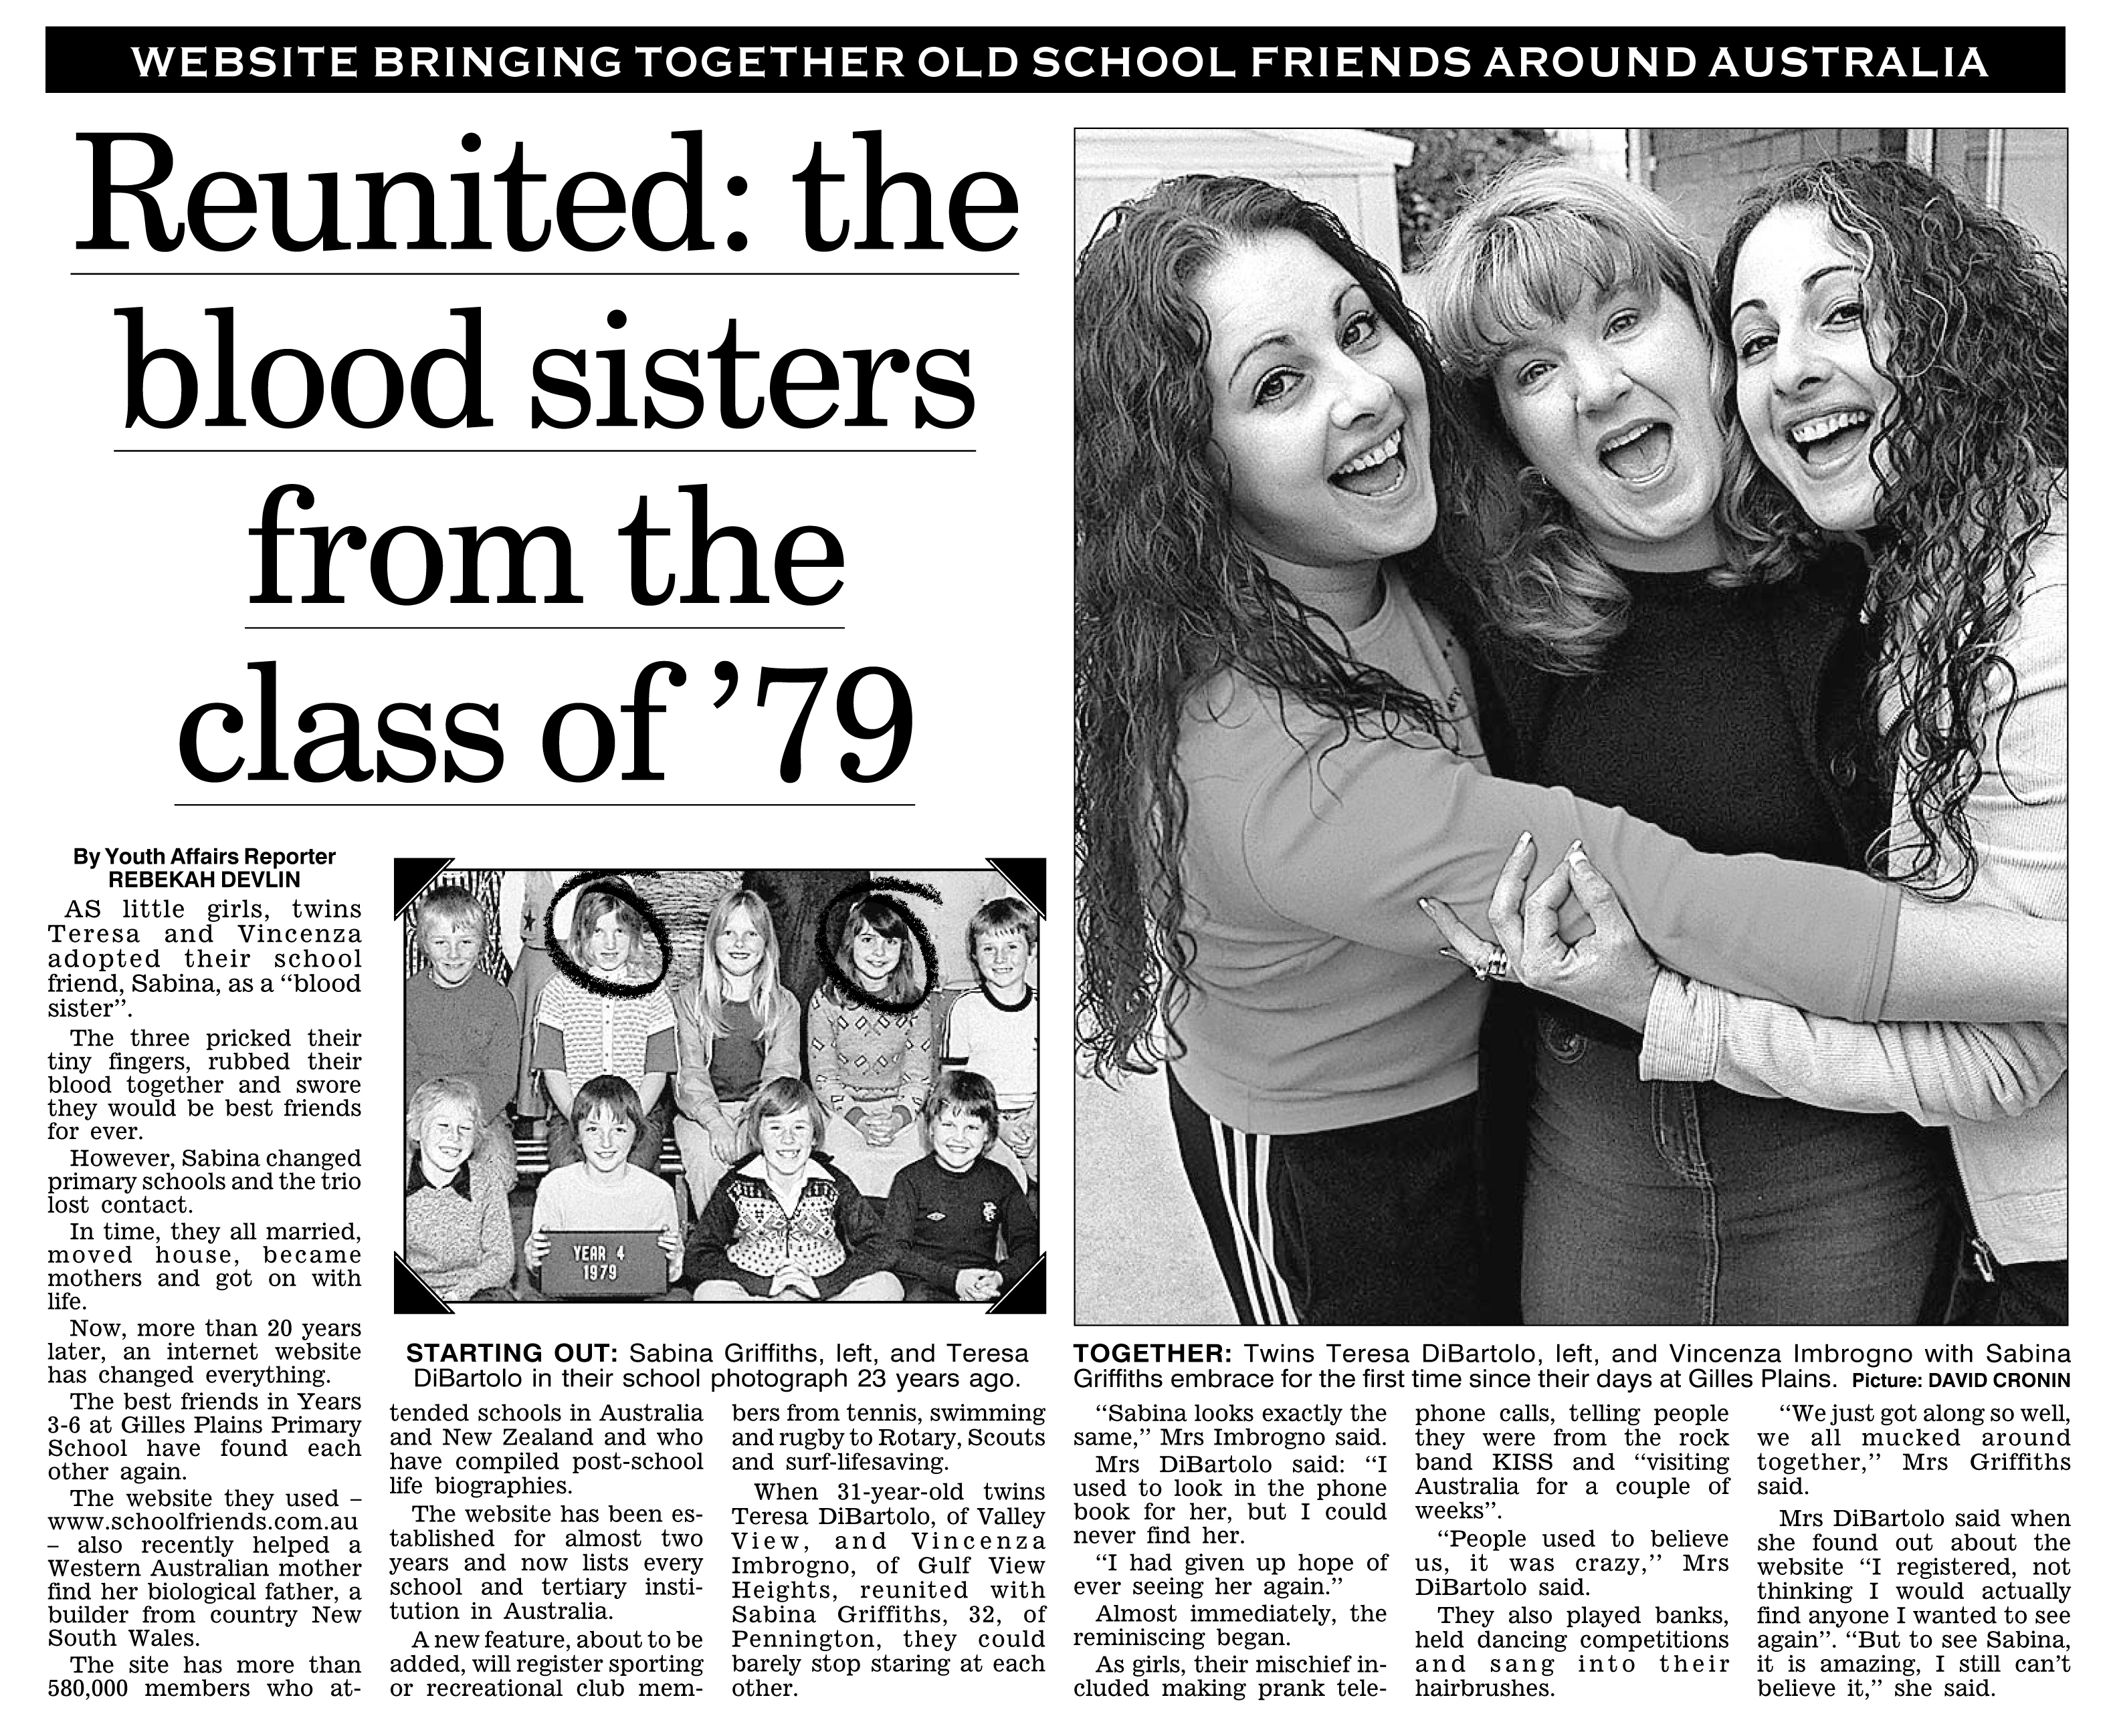
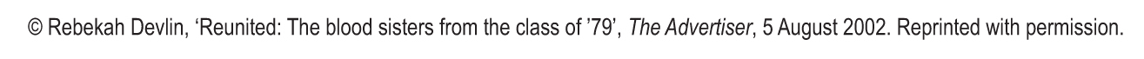
3
This is known as the headline.
The function of the headline is to grab the attention of the reader.
What would your headline be? How will you pull together the information that you are presenting on the page?
Lead the examiner to an understanding of what this page will show.
>Explorations of/into..
>Media Development..
>Experimentations..
Teaching ESL students in mainstream classrooms Module 6

Slide 4
4
> On this page I will…
> I have explored..
> I have refelcted on..
This is known as the strapline
or overline.
The function of the strapline or
overline is to elaborate briefly
on the headline.
What will your strapline
or overline be? This can be
the final thing that you do to
ell me what you did on this
page
Teaching ESL students in mainstream classrooms Module 6

Slide 5
5
Due to .. I have evaluated the ..
The goal was to..
My idea is to.. so I..
In this project I will…
This is a continuation of..
I wanted to understand how..
In this orientation, notice the careful recount of selected events in very brief paragraphs (only one sentence per paragraph).
Note that the order of the paragraphs follows the order in which the events actually happened.
We need an introduction. What is the topic/project/problem/ that you were addressing?
Next comes the orientation: the writer must introduce the people involved and give the necessary background information so that the reader can make sense of the story.
You then need to make sure that your information follows a logical order that helps the reader see how you reflected on what you did, made connections and what happened next.
Teaching ESL students in mainstream classrooms Module 6

Slide 6
HOW DOES THE NEWSPAPER DELIVER INFORMATION? And how can we use in a process portfolio page..
Banner heading: elaborate on what you have done on the page
Headline: Tell me what is on the page
Images: They are the main thing that we see. They are really important.
Orientation: Introduce the project/idea/problem..
Image references:
Each (yours and the artists work) need to have a reference.
Artist, Name of piece, (year), Media and support, size cm.
Support means what the work is on- canvas, paper..
Subheadings:
Divide your
Information into a logical order.
Body information: Keeping information in columns is a great idea, it makes it easier for the reader.

Slide 7
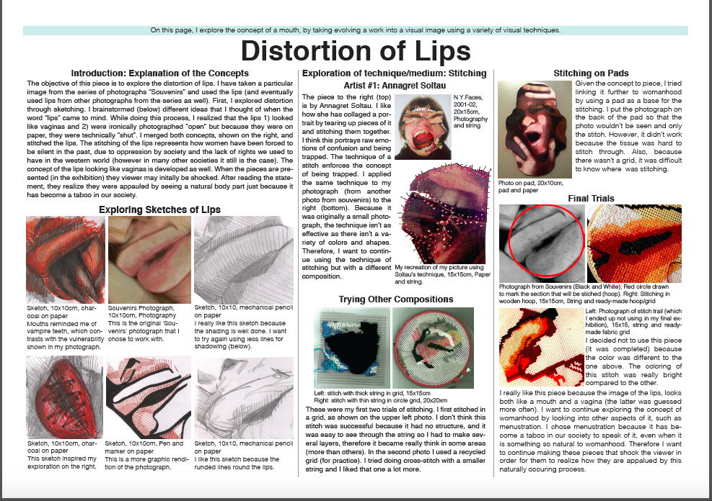

Slide 8
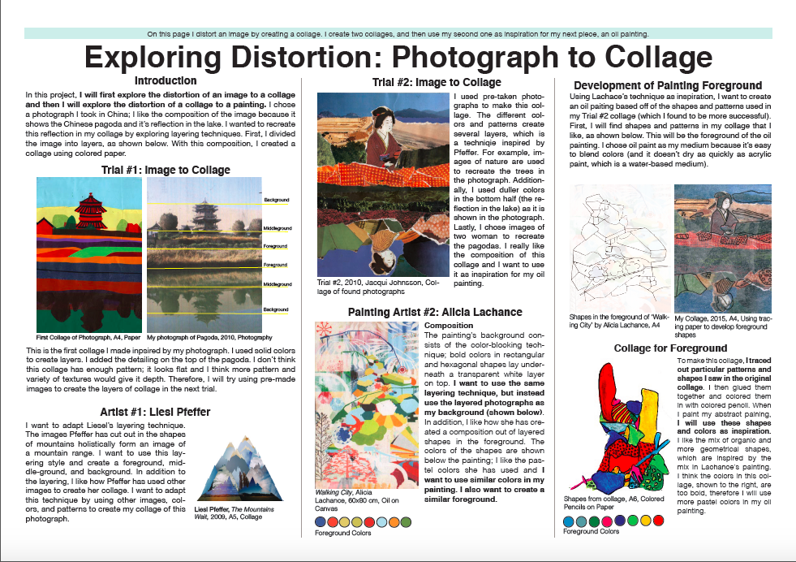

Slide 9
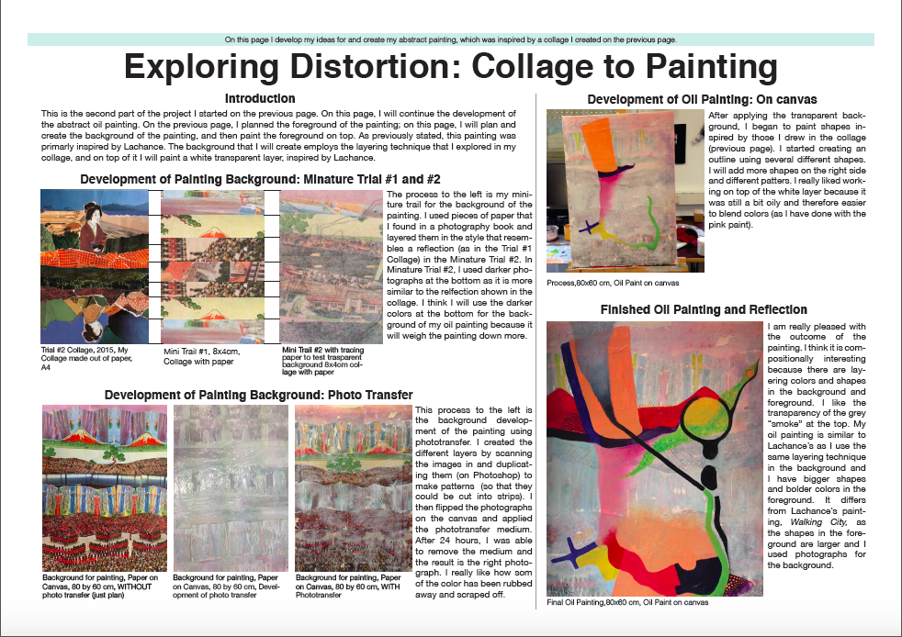

Slide 10
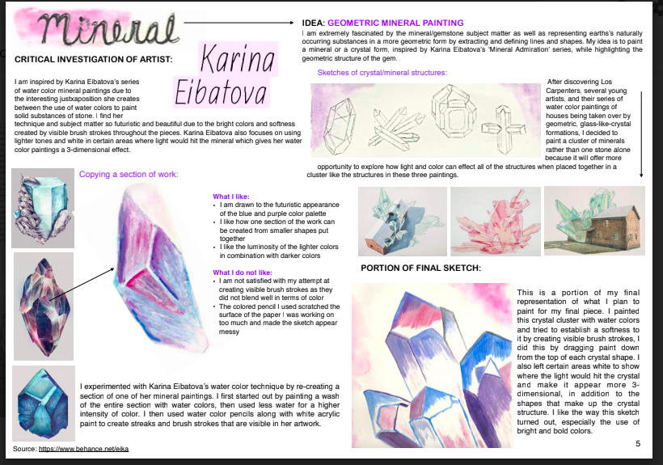

Slide 11
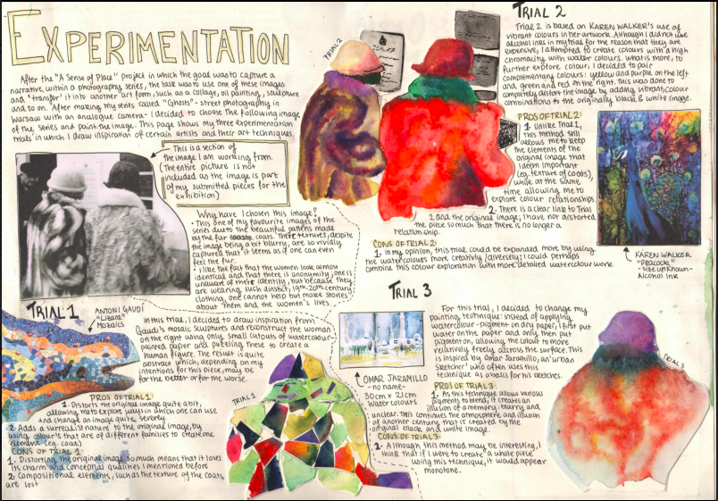

Slide 12
